Slide 1


Student Details
Name: NAIK MEHUL MANJUNATH
Skillsbuild Email Id: mehulnaik16@gmail.com
College Name: DR AMBEDKAR INSTITUTE OF TECHNOLOGY
College State: Karnataka
Domain: Artificial Intelligence
Start Date & End Date: 18 Aug 2023 to 30 Sep 2023

Slide 2
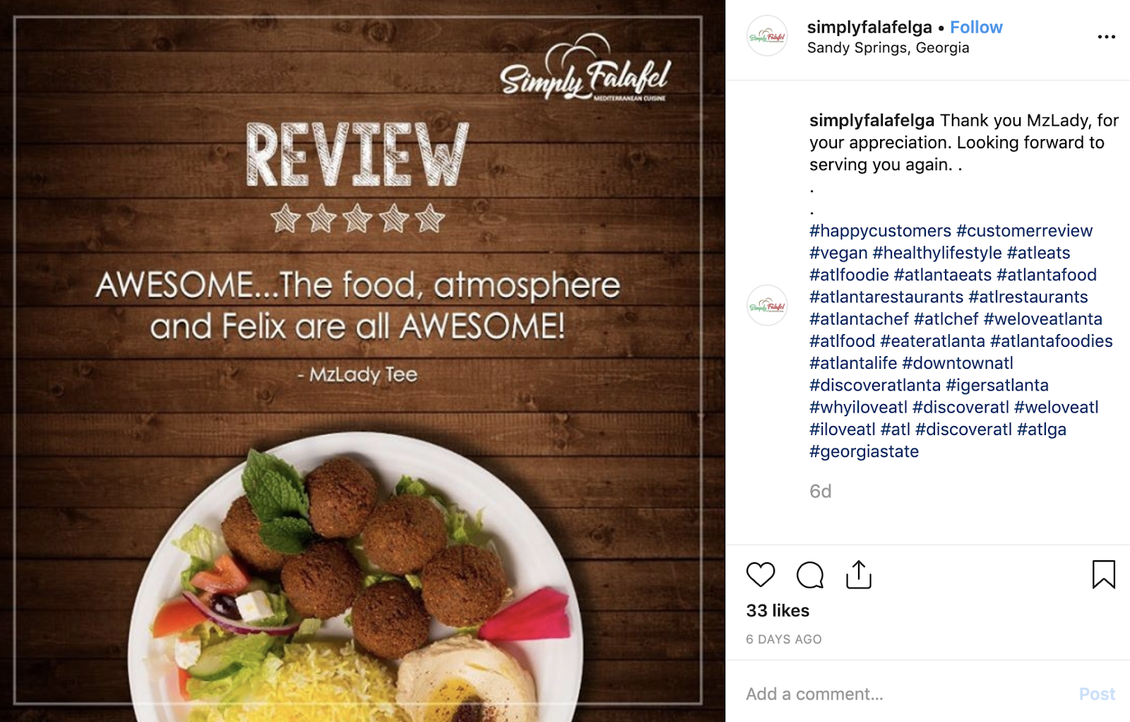
social media wields immense influence. Restaurants and food businesses leverage these platforms to promote their offerings, interact with customers, and showcase their culinary creations. Natural Language Processing (NLP) technology has become a vital tool in this context. NLP-driven sentiment analysis tools sift through the vast volume of food-related content on social media, helping establishments understand customer feedback. By analyzing the sentiments expressed in food reviews and social media posts, restaurants can gain actionable insights into what customers love or dislike, allowing them to tailor menus, improve service, and cultivate brand loyalty. Thus, the intersection of social media, food, and NLP is reshaping the way the food industry approaches customer satisfaction and business success.

Slide 3

AGENDA
we will commence with opening remarks, setting the stage for a focused discussion. The agenda will encompass critical elements of the project, including data collection and preprocessing, feature extraction techniques, sentiment labeling methods, and model selection. We will delve into the nuances of model training and evaluation, aiming to gain meaningful insights from the sentiment analysis results. Future steps, action items, timelines, and open discussions will provide a comprehensive outlook, fostering collaboration and ensuring project progress. This meeting aims to steer the project towards actionable outcomes within the restaurant and food service industry.

Slide 4

PROJECT OVERVIEW
PURPOSE
SCOPE
OBJECTIVE
Advancing technology and algorithms to enhance Understand customer feelings, improve quality, inform marketing, and enhance service for better dining experiences
Analyzing restaurant reviews to assess customer sentiments, identify areas for improvement, inform marketing strategies, and enhance overall dining experiences.
Enhance restaurant performance by analyzing reviews to improve quality, customer satisfaction, marketing strategies, and operational efficiency.

Slide 5



Who are the end users?
Restaurant
owners and managers
Food critics and
reviewers
Customer
Restaurant managers benefit by improving service, menu, and ambiance based on customer feedback, enhancing customer satisfaction, and increasing revenue.
Food critics benefit from data-driven insights, helping them make informed recommendations, critique restaurants accurately, and maintain credibility in reviews.
Customers benefit by making informed dining choices, experiencing improved service, and enjoying better food quality based on sentiment analysis insights.

Slide 6




solution
REVIEW
Natural Language Processing (NLP), the analysis of both bad and good restaurant reviews plays a pivotal role. When it comes to good reviews, NLP algorithms are adept at detecting and categorizing them based on positive sentiment analysis. They can identify keywords and phrases within reviews that customers commonly use to express their positive experiences. Additionally, NLP can predict high ratings by analyzing the textual content of these reviews.
MODEL
POSITIVE
NEGETIVE

Slide 7
Customization
Flexible
Scalable
High percentage
Greater accuracy
Count of feedbacks
Accuracy

Slide 8
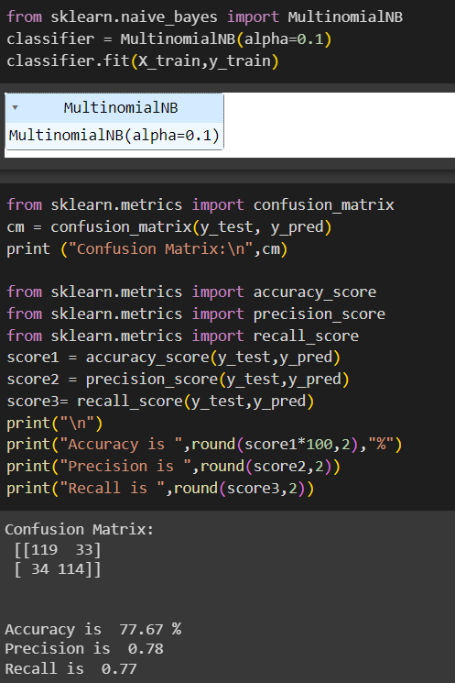
modelling
Sentiment analysis for reviews utilizes various machine learning and natural language processing (NLP)
1.Naïve Bayes: This simple probabilistic model is efficient and works well for text classification tasks, including sentiment analysis. It's particularly useful for binary sentiment classification (positive or negative).
2.Logistic Regression: Logistic regression is a linear model that can be used for sentiment analysis. It's straightforward to implement and can handle both binary and multiclass sentiment classification.
3.Support Vector Machines (SVM): SVMs are powerful for text classification tasks, including sentiment analysis. They work by finding a hyperplane that best separates the data into different sentiment classes.
4. Decision trees and random forests: can be employed for sentiment analysis. Random forests, in particular, are useful for reducing overfitting

Slide 9
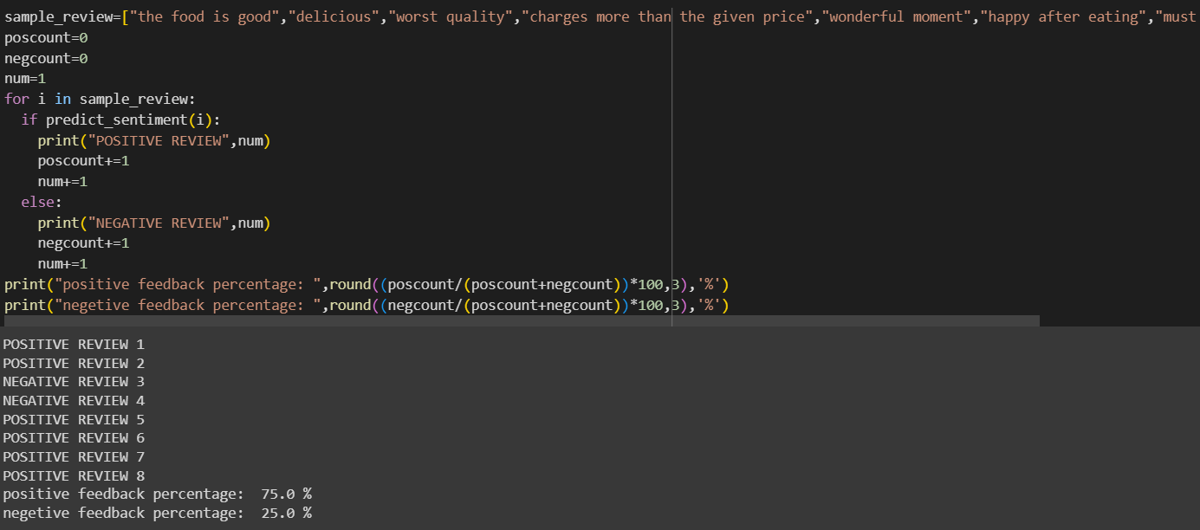
results
Based on our results for 7 inputs we get positive feedback of 75% and Negetive feedback of 25%

Slide 10


Links
(click to the image)

Slide 11


THANK YOU

